Slide 1








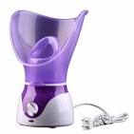
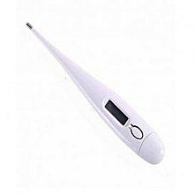
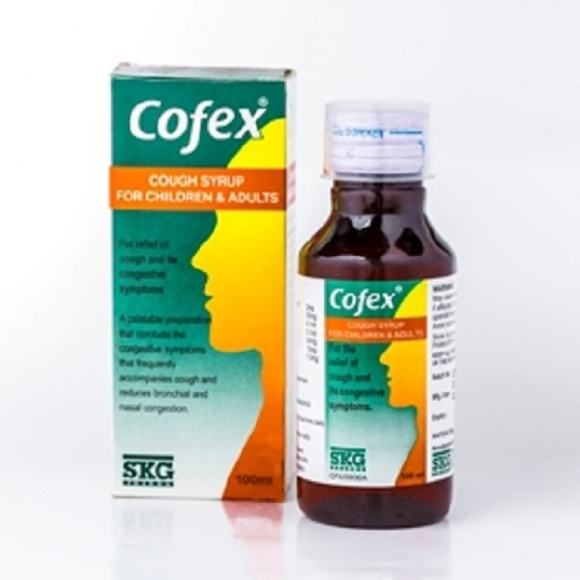
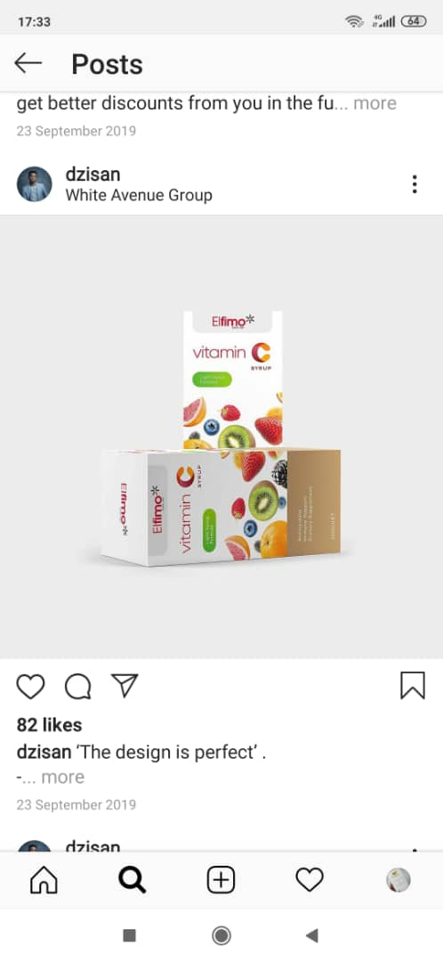






Welcome Nne!
1
Your Store: Elfimo Canal West Mall Osapa, Lekki
CHAT
Our
PHARMACIST
......Search for medication
ORDER
ONLINE
Featured Products
YZ Facial Steamer
N25,000
Ann’s Themometer
N25,000
COFEX Cough Syrup
N25,000
Elfimo Vita
N25,
Refill Prescriptions
Sympha 10mg…
Home
Membership
Shop
Transactions
Settings

Slide 2
FONTS
Featured Products
REQUEST/REFILL
......Search for medication
YZ Facial Steamer
N25,000

Slide 3







Your Store: Elfimo Canal West Mall Osapa, Lekki
Hello, Linez
CHAT
On-Call Pharmacist
......Search for medication
Featured Products
Shop
YZ Facial Steamer
N25,000
Ann’s Themometer
N25,000
COFEX Cough Syrup
N25,000
Elfimo Vita
N25,
NEED
Routine Medication?
REFILL NOW

Slide 4

Hello, Linez
CHAT
On-Call Pharmacist
FREE DELIVERY
LEKKI & AJAH
Promo ends February 2021
......Search for medication
Featured Products
Shop
YZ Facial Steamer
N25,000
Ann’s Themometer
N25,000
COFEX Cough Syrup
N25,000
Elfimo Vita
N25,
Home
Membership
Shop
Transactions
Settings

Slide 5
ACCOUNT
Personal Information
Name
Email address
Gender
Location
Phone number
Delivery Address
For VIP Membership
Doctor/Hospital
HMO
Alternative Contact
UPDATE INFORMATION

Slide 6
Antibiotics
Anti-malarial
Cough, Colds & Flu
Allergy & Sinus
Pain Relievers
Home Tests & Devices
Skin Ailments
Feminine Care
Eye Care
Ear, Nose & Throat
Herbals
Digestive Health
Sleep & Snoring Aids
Children’s Health
Vitamins & Supplements
Sexual Health
Pregnancy Care
Safety & Hygiene
Others
SHOP
Order Prescription
Categories
All OTC Meds & Personal care items
YZ Facial Steamer
N25,000
Ann’s Themometer
N25,000
COFEX Cough Syrup
N25,000
Elfimo Vita
N25,

Slide 7
SHOP
Prescription Order
Drug Name
Amount
Purchase code
Obtain from pharmacist
Pick - Up
Delivery Address
PAY NOW

Slide 8

V-I-P Member
(Very Important Prescriptions)
YOUR
PHARMACIST “Drugshopper”
Pharm Elfrida
Drug List
SS
SS
S
S
SS
SS
REQUEST/REFILL

Slide 9
NOTIFICATIONS
INBOX

